Slide 1

Stress and Health
Chapter 11

Slide 2
Chapter 11 Learning Objective Menu
LO 11.1 Stress
LO 11.2 Cognitive factors in stress
LO 11.3 Kinds of experiences causing stress
LO 11.4 Sources of stress in everyday life
LO 11.5 Suicide
LO 11.6 Types of conflict
LO 11.7 Bodily reaction to stress
LO 11.8 Relationship between stress and the immune system
LO 11.9 Relationship between stress and personality
LO 11.10 Relationship between stress and social factors
LO 11.11 Two ways to deal with stress
LO 11.12 Psychological defense mechanisms
LO 11.13 Meditation to relieve stress
LO 11.14 Cultural influences on stress
LO 11.15 How being religious helps to cope with stress
LO 11.16 Ways to promote wellness in one’s life

Slide 3

Stress
LO 11.1 Stress
Stress - the term used to describe the physical, emotional, cognitive, and behavioral responses to events that are appraised as threatening or challenging.
Stressors - events that cause a stress reaction.
Distress - the effect of unpleasant and undesirable stressors.
Eustress - the effect of positive events, or the optimal amount of stress that people need to promote health and well-being.
Menu

Slide 4
Cognitive Factors of Stress
LO 11.2 Cognitive factors in stress
Cognitive appraisal approach - states that how people think about a stressor determines, at least in part, how stressful that stressor will become.
  Primary appraisal - the first step in assessing a stress, which involves estimating the severity of a stressor and classifying it as either a threat or a challenge.
  Secondary appraisal - the second step in assessing a threat, which involves estimating the resources available to the person for coping with the stressor.
Menu

Slide 5
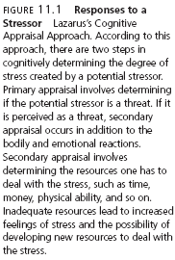
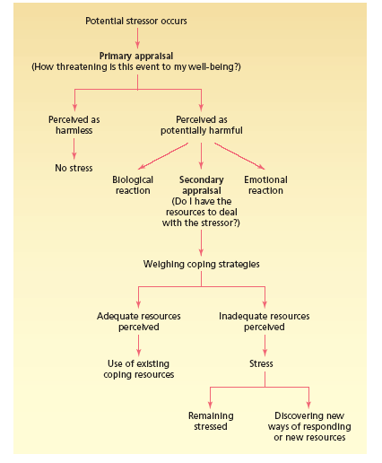
LO 11.2 Cognitive factors in stress
Menu

Slide 6
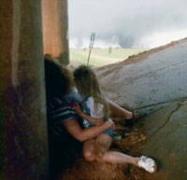
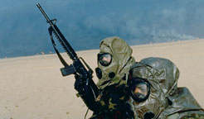
Causes of Stress
LO 11.3 Kinds of experiences causing stress
Catastrophe - an unpredictable, large-scale event that creates a tremendous need to adapt and adjust as well as overwhelming feelings of threat.
  Post-Traumatic Stress Disorder (PTSD) - a disorder resulting from exposure to a major stressor, with symptoms of anxiety, nightmares, poor sleep, reliving the event, and concentration problems, lasting for more than one month.
Menu

Slide 7
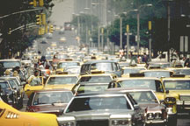
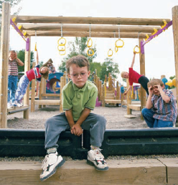
Causes of Stress
LO 11.3 Kinds of experiences causing stress
Major Life Events - cause stress by requiring adjustment.
  Social Readjustment Rating Scale (SRRS) - assessment that measures the amount of stress in a person’s life over a one-year period resulting from major life events.
  College Undergraduate Stress Scale (CUSS) - assessment that measures the amount of stress in a college student’s life over a one-year period resulting from major life events.
Hassles - the daily annoyances of everyday life.
Menu

Slide 8
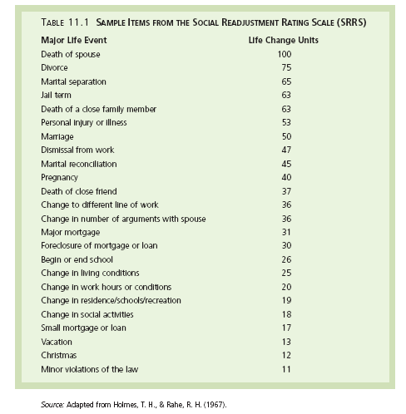
LO 11.3 Kinds of experiences causing stress
Menu

Slide 9
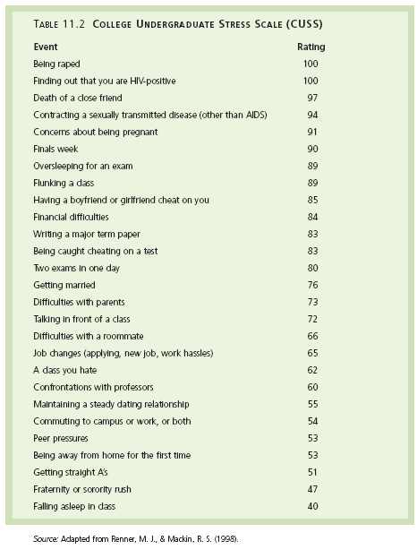
LO 11.3 Kinds of experiences causing stress
Menu

Slide 10
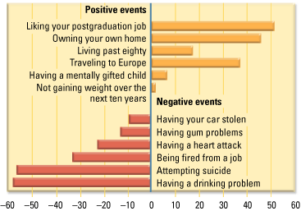
LO 11.3 Kinds of experiences causing stress
Menu

Slide 11
Everyday Sources of Stress
LO 11.4 Sources of stress in everyday life
Pressure - the psychological experience produced by urgent demands or expectations for a person’s behavior that come from an outside source.
Uncontrollability - the degree of control that the person has over a particular event or situation. The less control a person has, the greater the degree of stress.
Frustration - the psychological experience produced by the blocking of a desired goal or fulfillment of a perceived need.
Conflict - psychological experience of being pulled toward or drawn to two or more desires or goals, only one of which may be attained.
Menu

Slide 12
Everyday Sources of Stress
LO 11.4 Sources of stress in everyday life
Pressure - the psychological experience produced by urgent demands or expectations for a person’s behavior that come from an outside source.
Uncontrollability - the degree of control that the person has over a particular event or situation. The less control a person has, the greater the degree of stress.
Menu

Slide 13
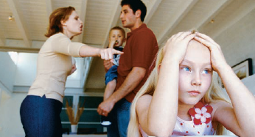
Everyday Sources of Stress
LO 11.4 Sources of stress in everyday life
Frustration - the psychological experience produced by the blocking of a desired goal or fulfillment of a perceived need. Possible reactions:
  Aggression - actions meant to harm or destroy.
  Displaced aggression – taking out one’s frustrations on some less threatening or more available target, a form of displacement.
  Escape or withdrawal - leaving the presence of a stressor, either literally or by a psychological withdrawal into fantasy, drug abuse, or apathy.
Conflict - psychological experience of being pulled toward or drawn to two or more desires or goals, only one of which may be attained.
Menu

Slide 14
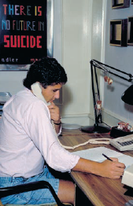
Suicide
LO 11.5 Suicide
Suicidal behavior is highly linked to depression.
People who talk about suicide should be taken seriously and need help.
Menu

Slide 15
Types of Conflict
LO 11.6 Types of conflict
Approach–approach conflict – conflict occurring when a person must choose between two desirable goals.
Avoidance–avoidance conflict - conflict occurring when a person must choose between two undesirable goals.
Approach–avoidance conflict - conflict occurring when a person must choose or not choose a goal that has both positive and negative aspects.
  Double approach–avoidance conflict - conflict in which the person must decide between two goals, with each goal possessing both positive and negative aspects.
  Multiple approach–avoidance conflict - conflict in which the person must decide between more than two goals, with each goal possessing both positive and negative aspects.
Menu

Slide 16
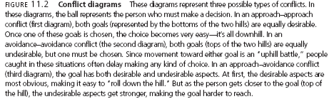
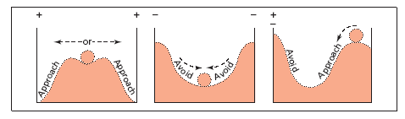
LO 11.6 Types of conflict
Menu

Slide 17
Bodily Reactions to Stress
LO 11.7 Bodily reactions to stress
Autonomic nervous system consists of:
  Sympathetic system - responds to stressful events
  Parasympathetic system - restores the body to normal functioning after the stress has ceased.
General Adaptation Syndrome (GAS) - the three stages of the body’s physiological reaction to stress, including alarm, resistance, and exhaustion.
Menu

Slide 18
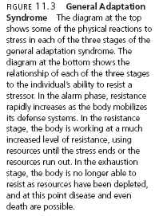
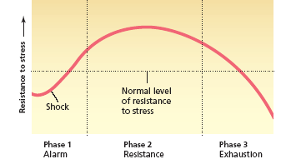
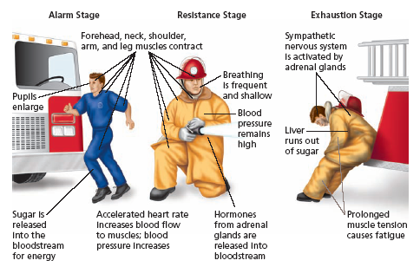
LO 11.7 Bodily reactions to stress
Menu

Slide 19
Stress and the Immune System
LO 11.8 Relationship between stress and the immune system
Immune system - the system of cells, organs, and chemicals of the body that responds to attacks from diseases, infections, and injuries.
  Negatively affected by stress.
Psychoneuroimmunology - the study of the effects of psychological factors such as stress, emotions, thoughts, and behavior on the immune system.
Natural killer cell - immune system cell responsible for suppressing viruses and destroying tumor cells.
Menu

Slide 20
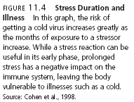
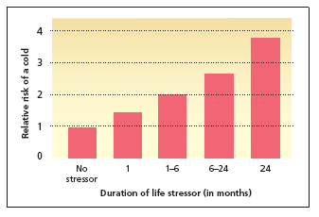
LO 11.8 Relationship between stress and the immune system
Menu

Slide 21

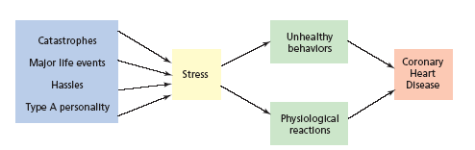
LO 11.8 Relationship between stress and the immune system
Menu

Slide 22
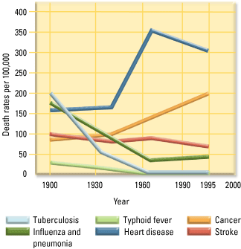
LO 11.8 Relationship between stress and the immune system
Menu

Slide 23
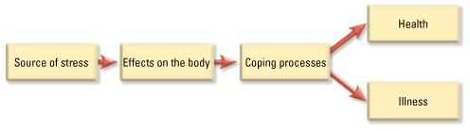
LO 11.8 Relationship between stress and the immune system
Menu

Slide 24
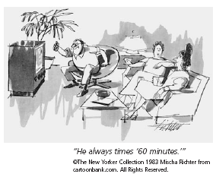
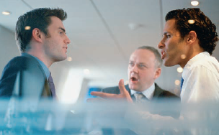
Stress and Personality
LO 11.9 Relationship between stress and personality
Type A personality - person who is ambitious, time conscious, extremely hardworking, and tends to have high levels of hostility and anger as well as being easily annoyed.
Type B personality - person who is relaxed and laid-back, less driven and competitive than Type A, and slow to anger.
Menu

Slide 25
Stress and Personality
LO 11.9 Relationship between stress and personality
Type C personality - pleasant but repressed person, who tends to internalize his or her anger and anxiety and who finds expressing emotions difficult.
Hardy personality - a person who seems to thrive on stress but lacks the anger and hostility of the Type A personality.
Menu

Slide 26
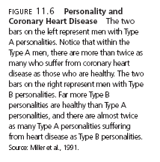
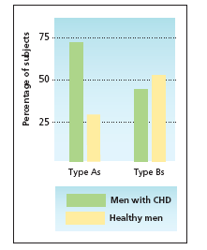
LO 11.9 Relationship between stress and personality
Menu

Slide 27
Stress and Personality
LO 11.9 Relationship between stress and personality
Optimists - people who expect positive outcomes.
Pessimists - people who expect negative outcomes.
Menu

Slide 28
Stress and Social Factors
LO 11.10 Relationship between stress and social factors
Social factors increasing the effects of stress include poverty, stresses on the job or in the workplace, and entering a majority culture that is different from one’s culture of origin
Burnout - negative changes in thoughts, emotions, and behavior as a result of prolonged stress or frustration.
Menu

Slide 29
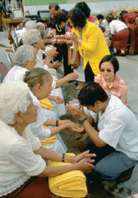
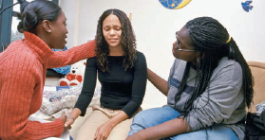
Stress and Social Factors
LO 11.10 Relationship between stress and social factors
Acculturative stress - stress resulting from the need to change and adapt a person’s ways to the majority culture.
  Four Methods of Acculturation:
  Integration
  Assimilation
  Separation
  Marginalization
Social support system - the network of family, friends, neighbors, coworkers, and others who can offer support, comfort, or aid to a person in need.
Menu

Slide 30
Ways to Deal with Stress
LO 11.11 Two ways to deal with stress
Coping strategies - actions that people can take to master, tolerate, reduce, or minimize the effects of stressors.
  Problem-focused coping- coping strategies that try to eliminate the source of a stress or reduce its impact through direct actions.
  Emotion-focused coping - coping strategies that change the impact of a stressor by changing the emotional reaction to the stressor.
Menu

Slide 31
Defense Mechanisms
LO 11.12 Psychological defense mechanisms
Psychological defense mechanisms - unconscious distortions of a person’s perception of reality that reduce stress and anxiety.
Denial - psychological defense mechanism in which the person refuses to acknowledge or recognize a threatening situation.
Repression - psychological defense mechanism in which the person refuses to consciously remember a threatening or unacceptable event, instead pushing those events into the unconscious mind.
Menu

Slide 32
Defense Mechanisms
LO 11.12 Psychological defense mechanisms
Rationalization - psychological defense mechanism in which a person invents acceptable excuses for unacceptable behavior.
Projection - psychological defense mechanism in which unacceptable or threatening impulses or feelings are seen as originating with someone else, usually the target of the impulses or feelings.
Menu

Slide 33
Defense Mechanisms
LO 11.12 Psychological defense mechanisms
Reaction formation - psychological defense mechanism in which a person forms an opposite emotional or behavioral reaction to the way he or she really feels to keep those true feelings hidden from self and others.
Displacement - redirecting feelings from a threatening target to a less threatening one.
Regression - psychological defense mechanism in which a person falls back on childlike patterns of responding in reaction to stressful situations.
Menu

Slide 34
Defense Mechanisms
LO 11.12 Psychological defense mechanisms
Identification - defense mechanism in which a person tries to become like someone else to deal with anxiety.
Compensation (substitution) - defense mechanism in which a person makes up for inferiorities in one area by becoming superior in another area.
Sublimation - channeling socially unacceptable impulses and urges into socially acceptable behavior.
Menu

Slide 35
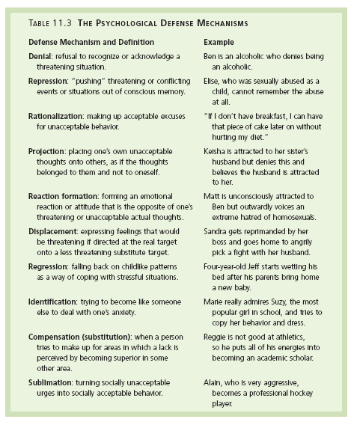
LO 11.12 Psychological defense mechanisms
Menu

Slide 36
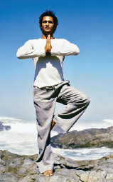
Meditation
LO 11.13 Meditation to relieve stress
Meditation - mental series of exercises meant to refocus attention and achieve a trancelike state of consciousness.
Concentrative meditation - form of meditation in which a person focuses the mind on some repetitive or unchanging stimulus so that the mind can be cleared of disturbing thoughts and the body can experience relaxation.
Receptive meditation - form of meditation in which a person attempts to become aware of everything in immediate conscious experience, or an expansion of consciousness.
Menu

Slide 37
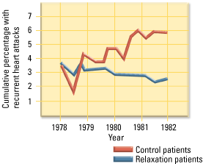
LO 11.13 Meditation to relieve stress
Menu

Slide 38
Cultural Influences on Stress
LO 11.14 Cultural influences on stress
Different cultures perceive stressors differently.
Coping strategies will also vary from culture to culture.
Menu

Slide 39
Religiosity and Stress
LO 11.15 How being religious helps to cope with stress
People with religious beliefs also have been found to cope better with stressful events.
Menu

Slide 40
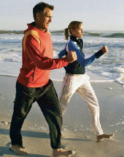
Factors Promoting Wellness
LO 11.16 Ways to promote wellness in one’s life
Exercise
Social activities
Getting enough sleep
Eating healthy foods
Having fun
Managing one’s time
Practicing good coping skills
Menu

